Slide 1


CI/CD with Protractor and Dev Ops Basic
Prepared By: Shrish Tripathi

Slide 2
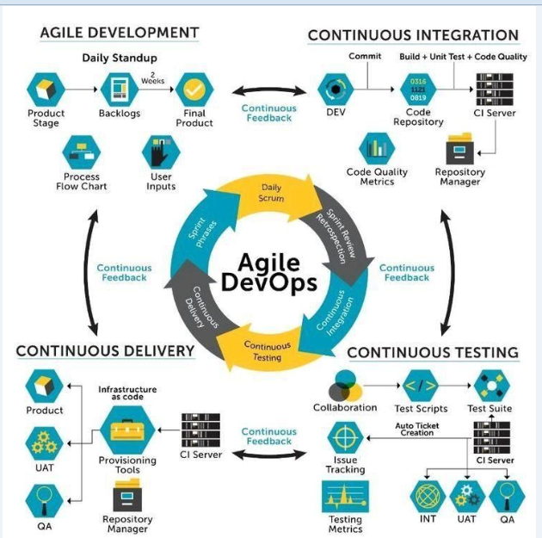

Slide 3
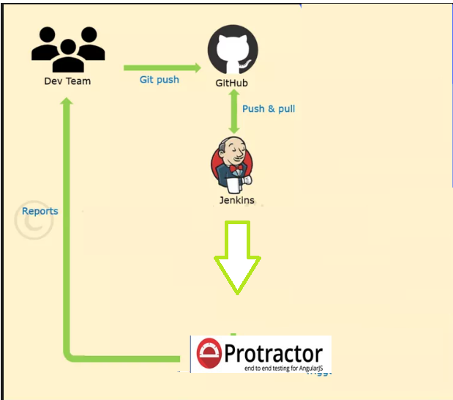
Continuous Testing

Slide 4
Jenkins

Slide 5
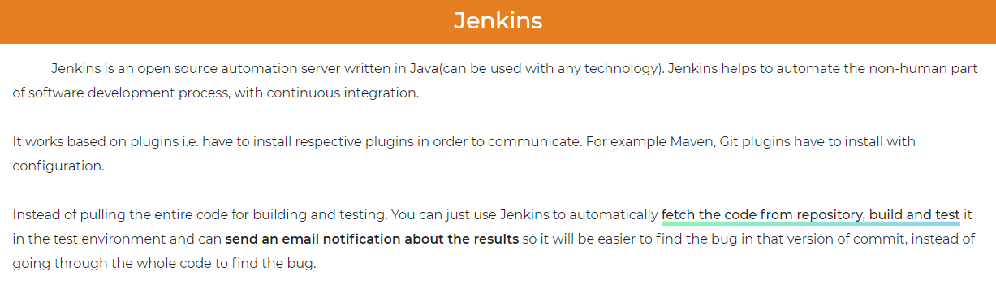

Slide 6
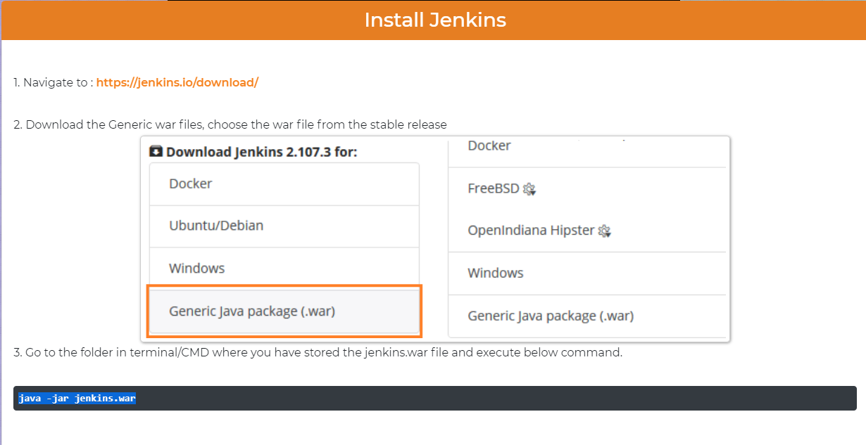

Slide 7
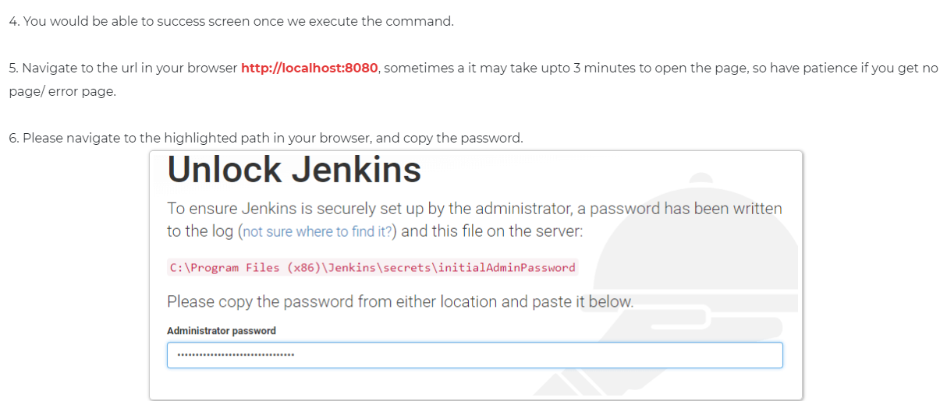

Slide 8
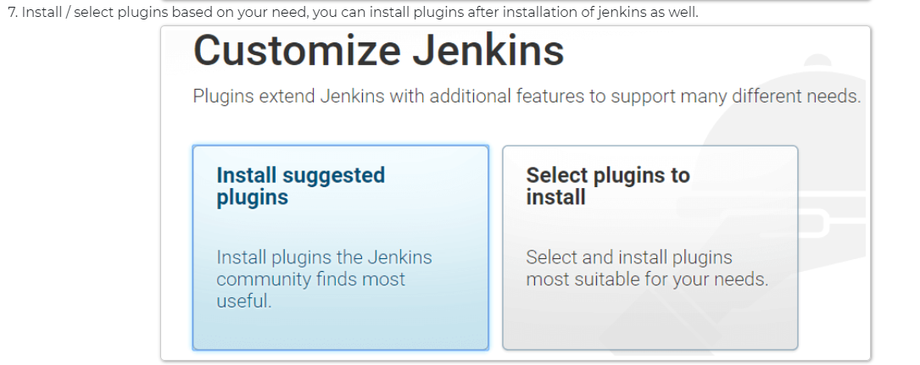

Slide 9
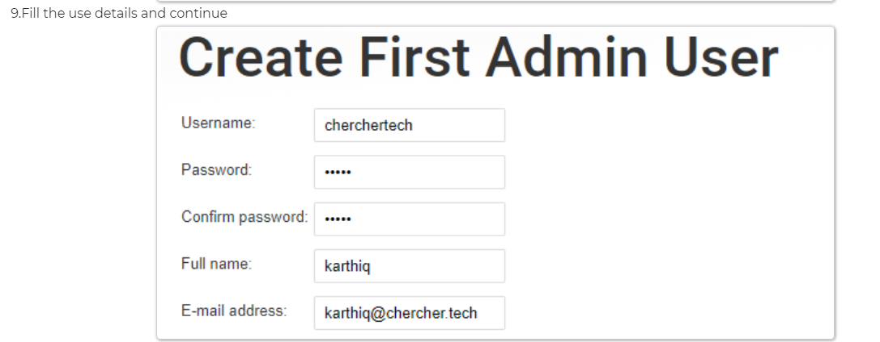

Slide 10


Slide 11
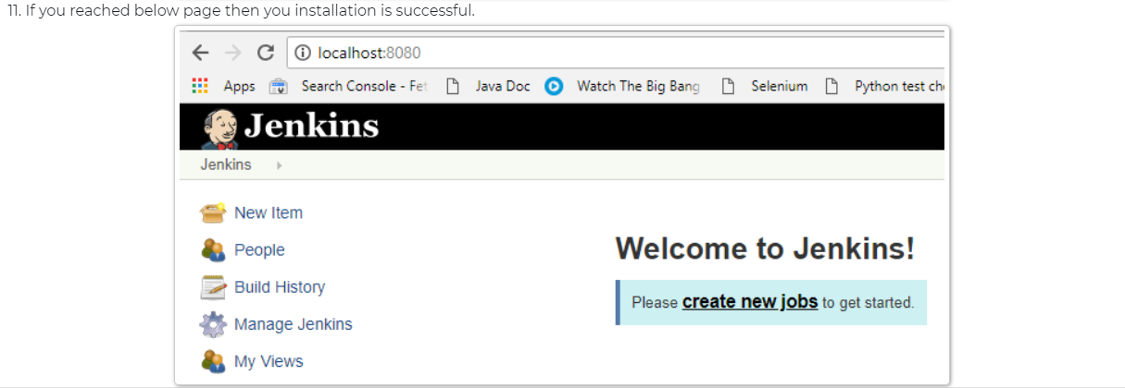

Slide 12
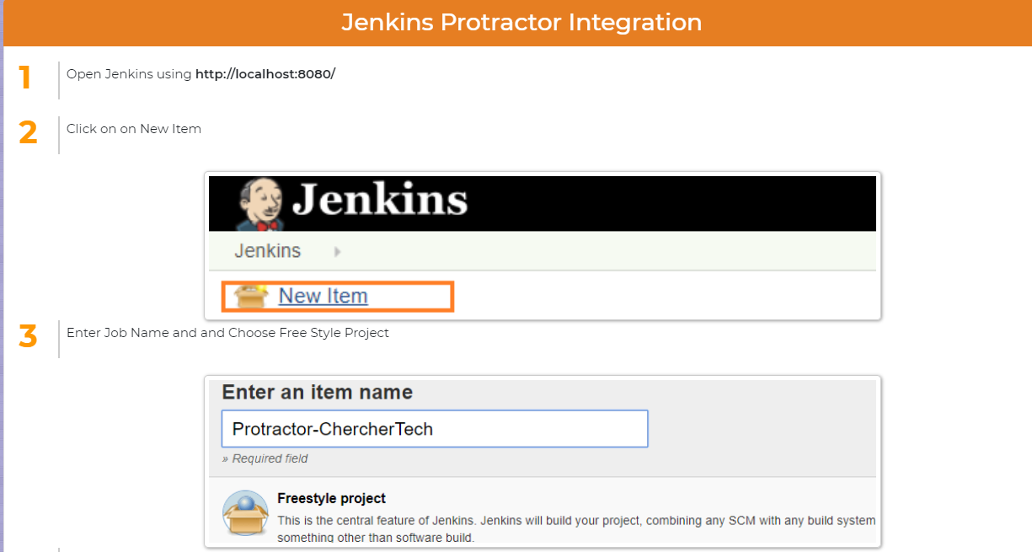

Slide 13
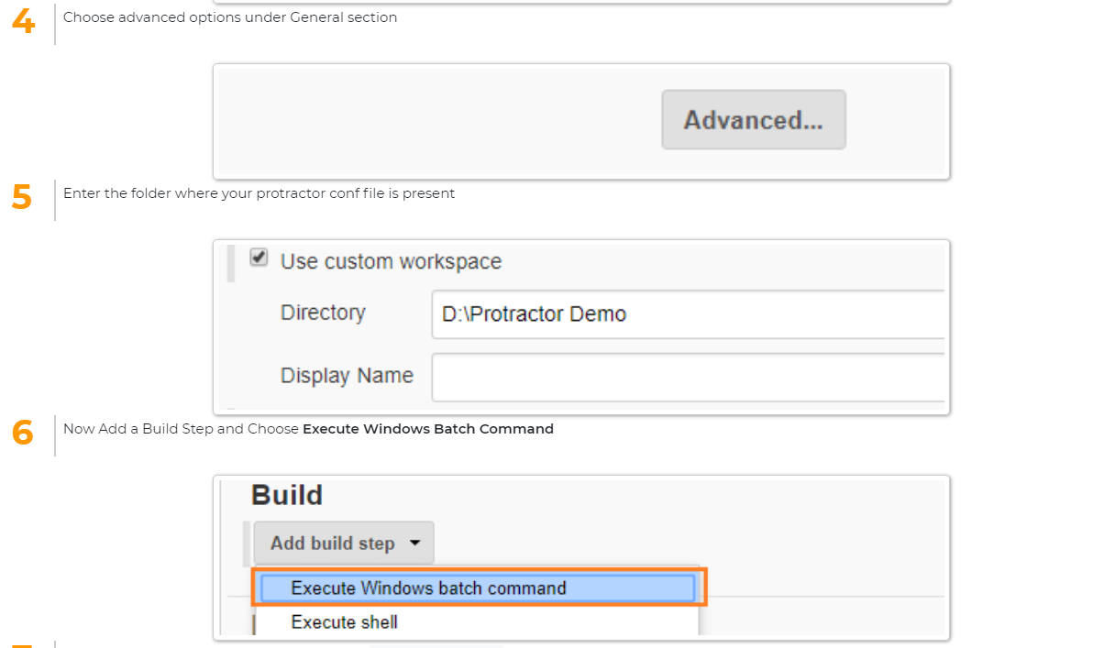

Slide 14
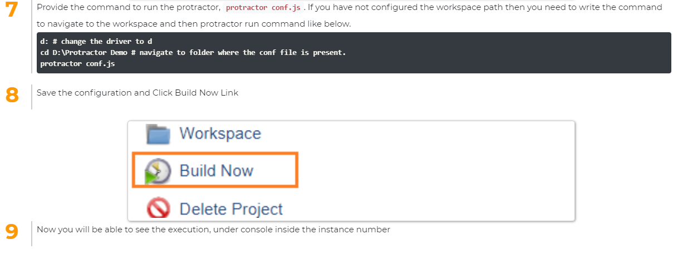

Slide 15
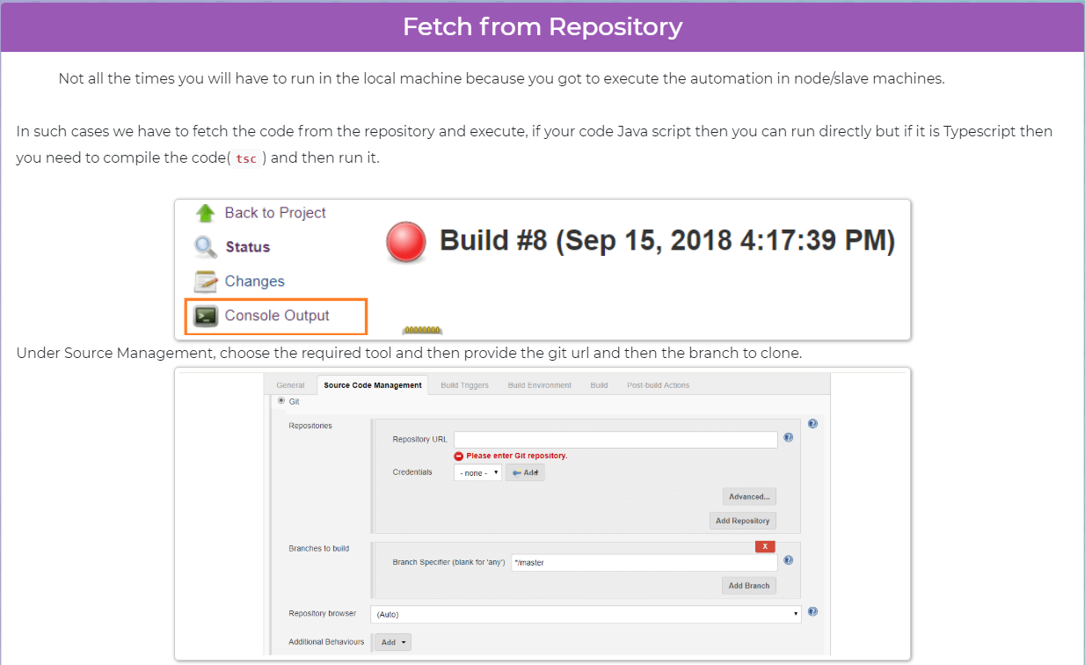

Slide 16
How to create project repositories in GITHUB

Slide 17
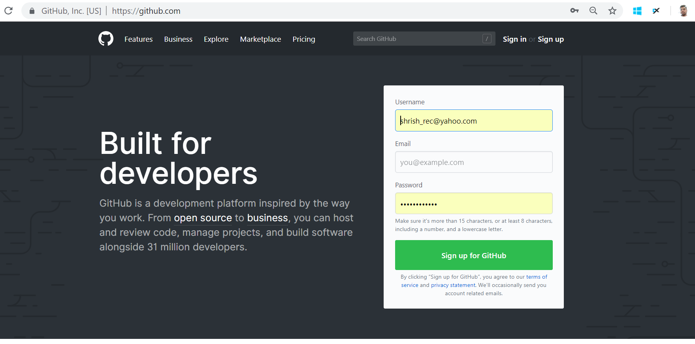

Slide 18
cd project directory

Slide 19
Git init

Slide 20
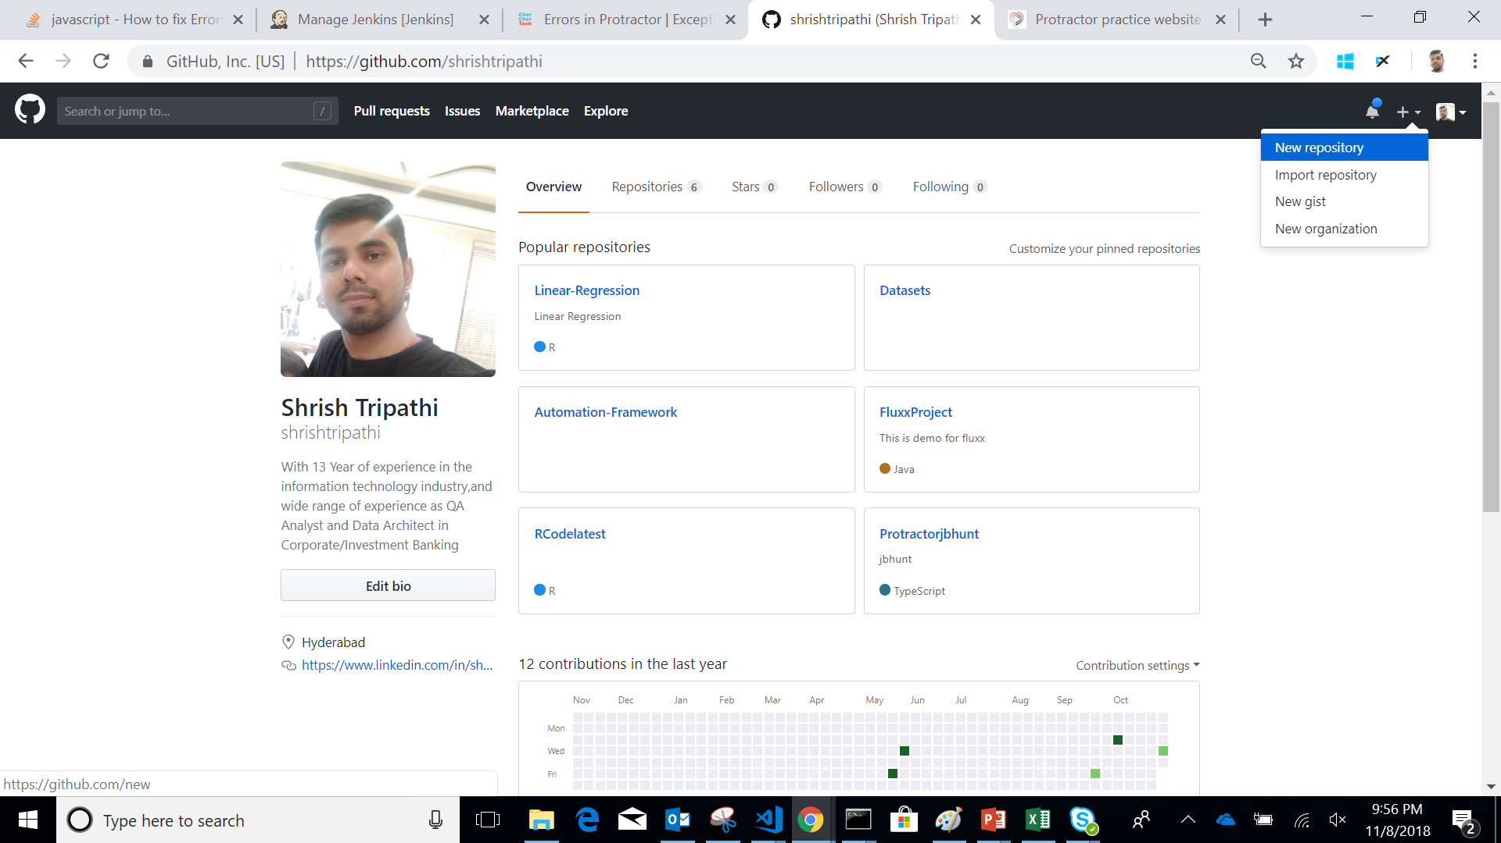

Slide 21
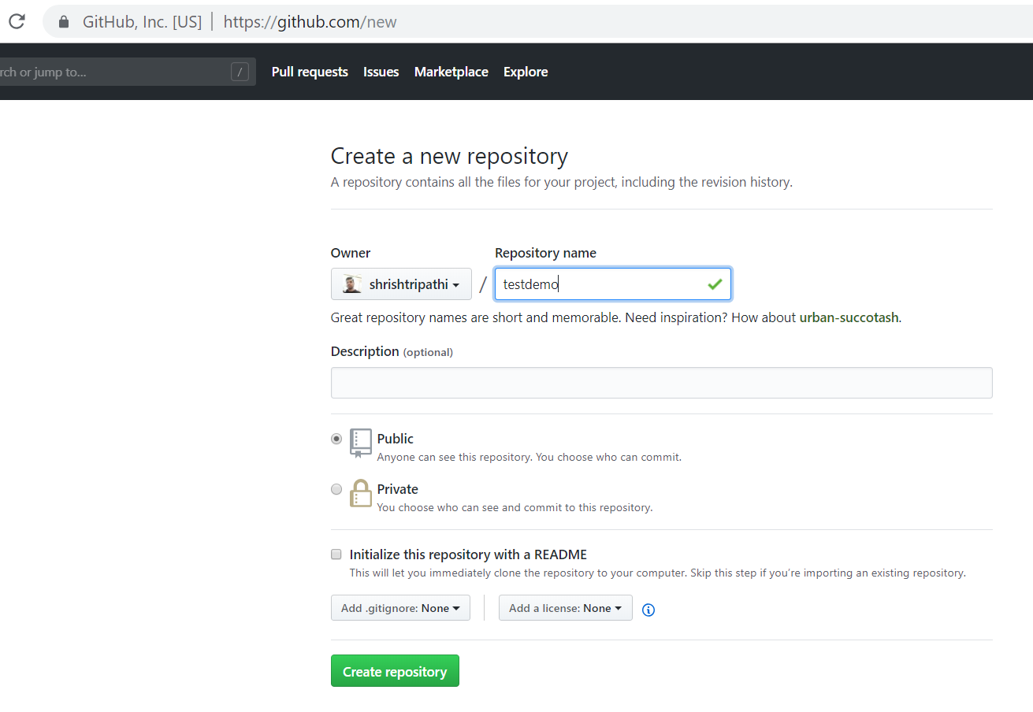

Slide 22
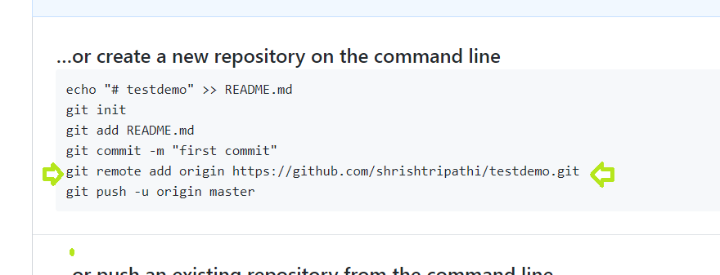

Slide 23
git add .

Slide 24
git status

Slide 25
git commit –m “First Commit”

Slide 26
git push –u origin master
Ask for user name and password

Slide 27
PULL is easy->
Any one can pull the code
git clone git url

Slide 28
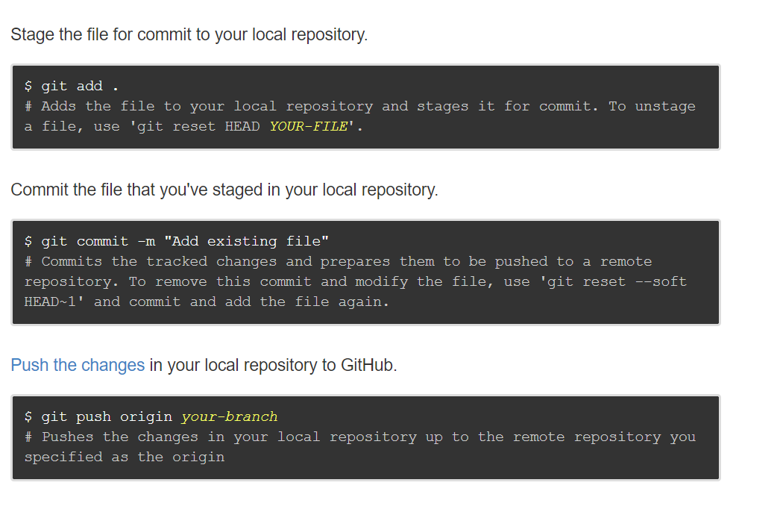
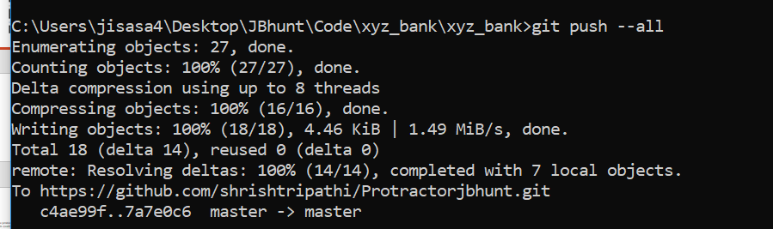
Push newly added file or changes to git repository

Slide 29
Parallel Execution- Master and Slaves

Slide 30
One problem we always encounter is how to run all the tests needed to ensure high-quality changes while still keeping pipeline times reasonable and changes flowing smoothly. More tests mean greater confidence, but also longer wait times. Build systems may or may not support running tests in parallel, but they still only use one machine even while other lab machines sit idle. In these cases, parallelizing test execution across multiple machines is a great way to speed up pipelines. The Parallel Test Executor plugin lets us leverage Jenkins do just that with no disruption to the rest of the build system.

Slide 31
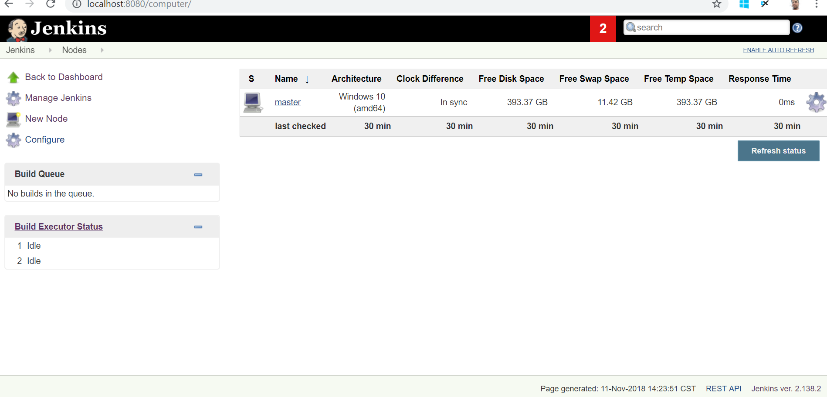

Slide 32
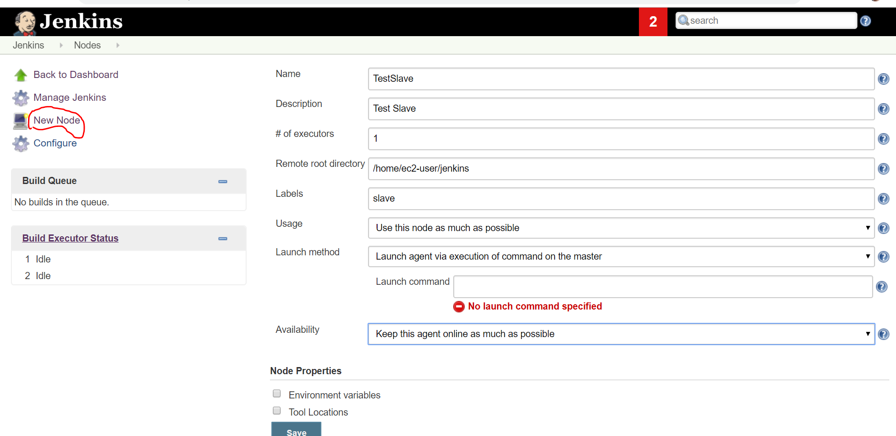

Slide 33
Thanks

